Slide 1
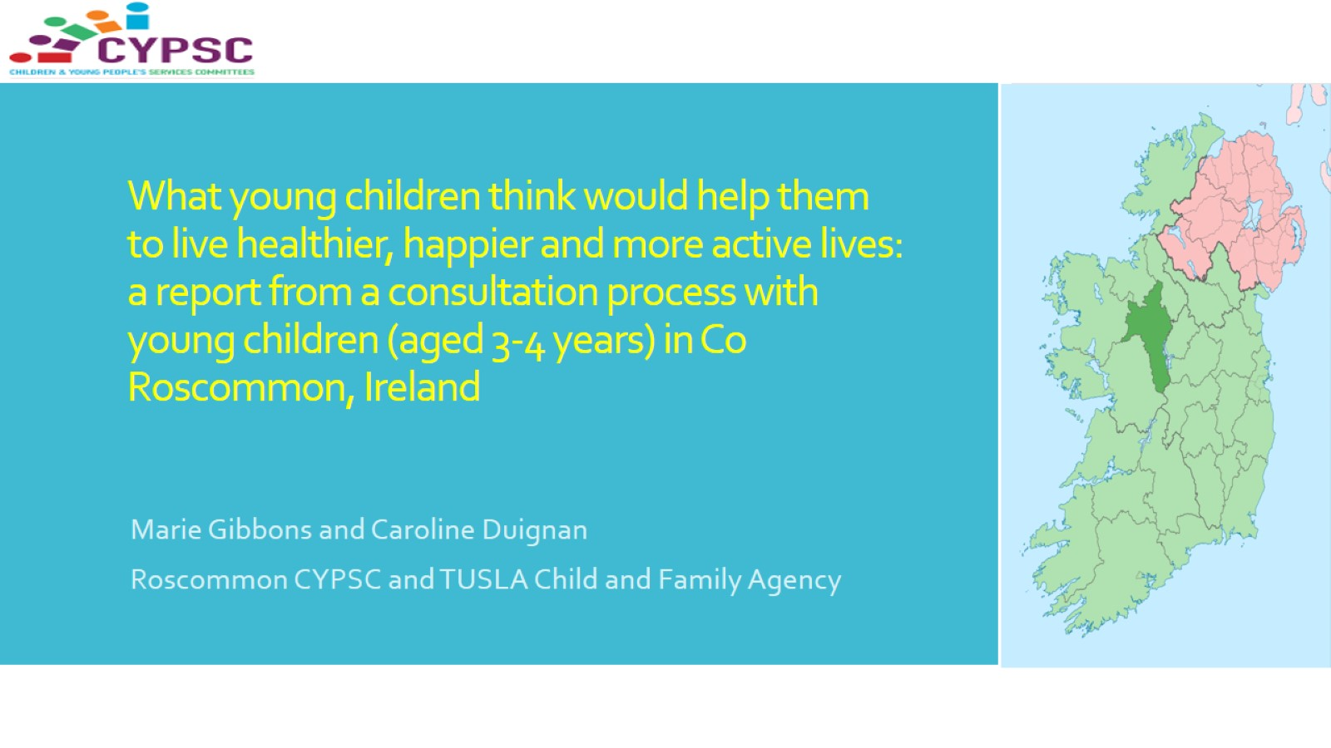
What young children think would help them to live healthier, happier and more active lives: a report from a consultation process with young children (aged 3-4 years) in Co Roscommon, Ireland

Slide 2


Slide 3
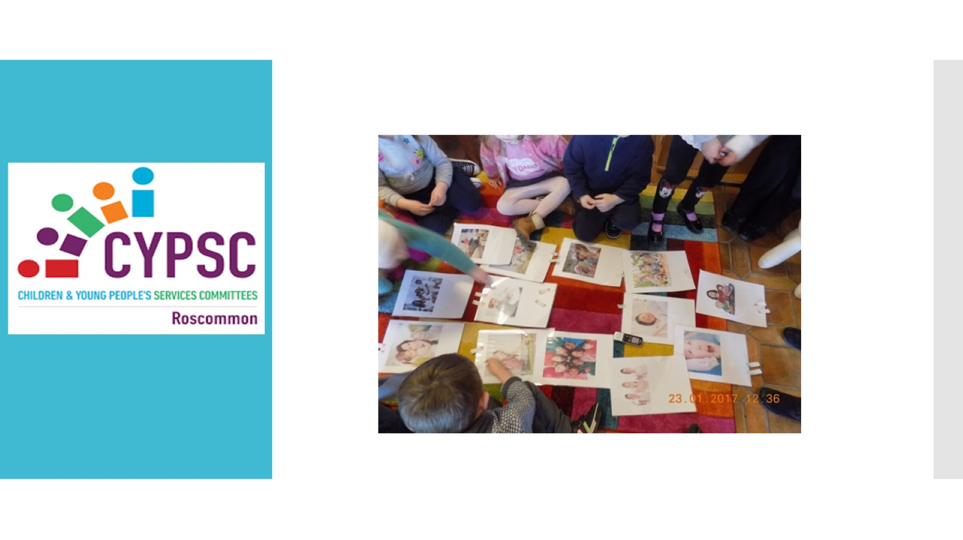

Slide 4
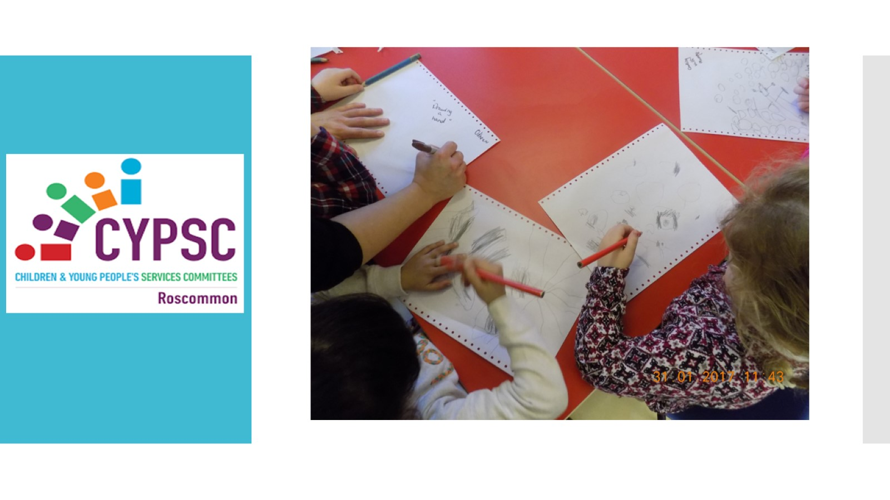

Slide 5
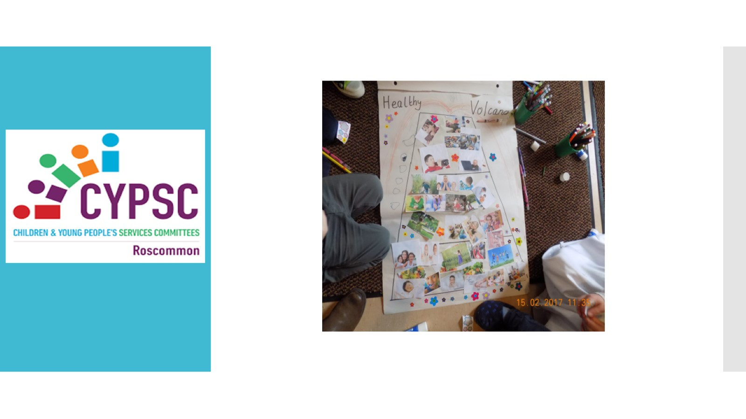

Slide 6

https://www.cypsc.ie/news-events/happy-and-healthy-volcano.2502.html

Slide 7
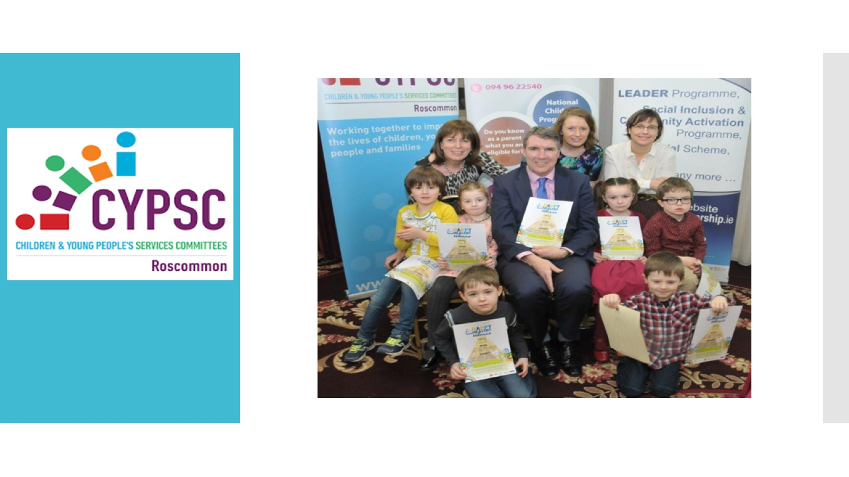

Slide 8
